Slide 1
Rolling Thunder
By : David Vaughan, Roman Tait,
Tucker Hoffnagle, Karlton Hall,
Harrison Whitworth

Slide 2

Project Overview
LLM Assisted Technical Order Management Tool
Provide a Large Language Model (LLM) that has the capability to search and implement Air Force Technical Order Management specifications and directions.
Notes:
We’re developing a LLM assisted technical order management tool. This tool will be able to search and retrieve air force technical order management specifications and directions. Simply put the air force has many technical manuals where they will need to look up certain codes and definitions but the manuals are very long and extensive. Our tool aims to simplify this process, it will be a web page in which you can simply input questions pertaining to this information and it will output the desires code or definition. Through the rest of this presentation we will talk about some requirements, our implementation plan and tools we’re going to use, some diagrams to show how everything is connected, and lastly our website.

Slide 3
Project Requirements - Reminder
Question/Answer capability (through website)
Accuracy verification capability (no hallucinations)
Traceability of data source (indicated in responses)
Respond to user input within 3 seconds (or use loading bar)
Be available online through a website (github)
Notes:
First off the biggest thing is the question and answer capabilities through the website. Next we need to be able to verify that this information we’re returning is indeed accurate to the technical manuals. We need to be able to trace exactly where the answer came from within the technical manuals. Have a decent running time, below 3 seconds or being able to show the program is still running like a loading bar. Finally be available through our website on github. These are the core requirements of this project. I’m gonna pass it off to roman to talk about the implementation methods and plan.

Slide 4
Implementation Methods - Reminder
Retrieval-augmented generation (RAG).
Search database using tokenized question and providing LLM with question and relevant documents
Fine Tuning
Modify LLM to provide better answers from the question and documents given
Notes:
Our source data is the AF-TO pdfs, stored on github.
This data is split into smaller pieces and converted into vectors, called embeddings. These embeddings are then stored into a vector database.
User questions are then converted into embeddings, and are compared to the database to retrieve relevant answers.
We have two main implementation methods that we are using. The first and primary one is Retrieval Augmented Generation, or RAG.
With RAG, we first take our source data, the AF-TO documents stored on GitHub, and split it into smaller pieces. These small pieces are then converted into vectors,
called “embeddings”. We then take these embeddings and store them into a vector database.
The LLM is then given the user question. This question is converted into an embedding and searches through the database for relevant information to return a proper answer. The question-answer is saved so that the LLM can “remember” recent past conversation.

Slide 5







Implementation Tools
Hugging Face
FAISS
LangChain
React
LLM & Tokenizer
Vector/Embedding Database
Vectorize & Index Database
Frontend
GitHub
HPCC
Google Colab
Code Development
Run & Fine Tune Model
Notes:
Falcon 7B and a tokenizer, from Hugging Face. Tokenizer prepares the inputs for the model, turns data into tokens.
We went with the Falcon 7B model as it performs well when compared to other open-source models like MPT-7B and StableLM. As it is made available with the Apache 2.0 license, it is usable without royalties or restrictions.
It requires 16 GB of memory, so it’s a good middle ground for performance and usability. The Falcon 7B Model is also meant to be fine tuned for most usecases, making it the perfect fit for our project.
Facebook AI Similarity Search, for the vector database, from META.
LangChain, to vectorize and index the database.
React, for frontend implementation.
GitHub and Google Colab, for code development.
TTU High Performance Computing Center (HPCC), to run and fine tune the falcon model.

Slide 6
Model & Tool Selection
Facebook AI Similarity Search (FAISS)
Enhance efficiency of data retrieval & processing
Falcon 7B
Balance of performance & usability
Meant to be fine tuned
Open source
Tokenizer
Converts data into tokens
LangChain
Vectorization & Indexing techniques for efficient database management
Notes:
Falcon 7B and a tokenizer, from Hugging Face. Tokenizer prepares the inputs for the model, turns data into tokens.
We went with the Falcon 7B model as it performs well when compared to other open-source models like MPT-7B and StableLM. As it is made available with the Apache 2.0 license, it is usable without royalties or restrictions.
It requires 16 GB of memory, so it’s a good middle ground for performance and usability. The Falcon 7B Model is also meant to be fine tuned for most usecases, making it the perfect fit for our project.
Tools
We opted for tools like Hugging Face tokenizer, Facebook AI Similarity Search, and LangChain due to their specific functionalities. These tools ensure efficient processing, storage, and retrieval of data within the project.
Facebook AI Similarity Search, for the vector database, from META.
LangChain, to vectorize and index the database

Slide 7
Development Environment
Google Colab
Code development, testing, and updates
Enables seamless collaboration and real-time code changes
React
Ensures a user-friendly interface & smooth user experience
GitHub
Utilized for version control
Collaborative code development/management
TTU HPCC
Utilizes the power of high-performance computing for complex computations
Notes:
React, for frontend implementation.
GitHub and Google Colab facilitate collaborative development by providing version control and seamless teamwork capabilities. Additionally, utilizing HPCC ensures the efficient running and fine-tuning of the model, thereby optimizing the project's overall performance.
GitHub and Google Colab, for code development.
TTU High Performance Computing Center (HPCC), to run and fine tune the falcon model.

Slide 8
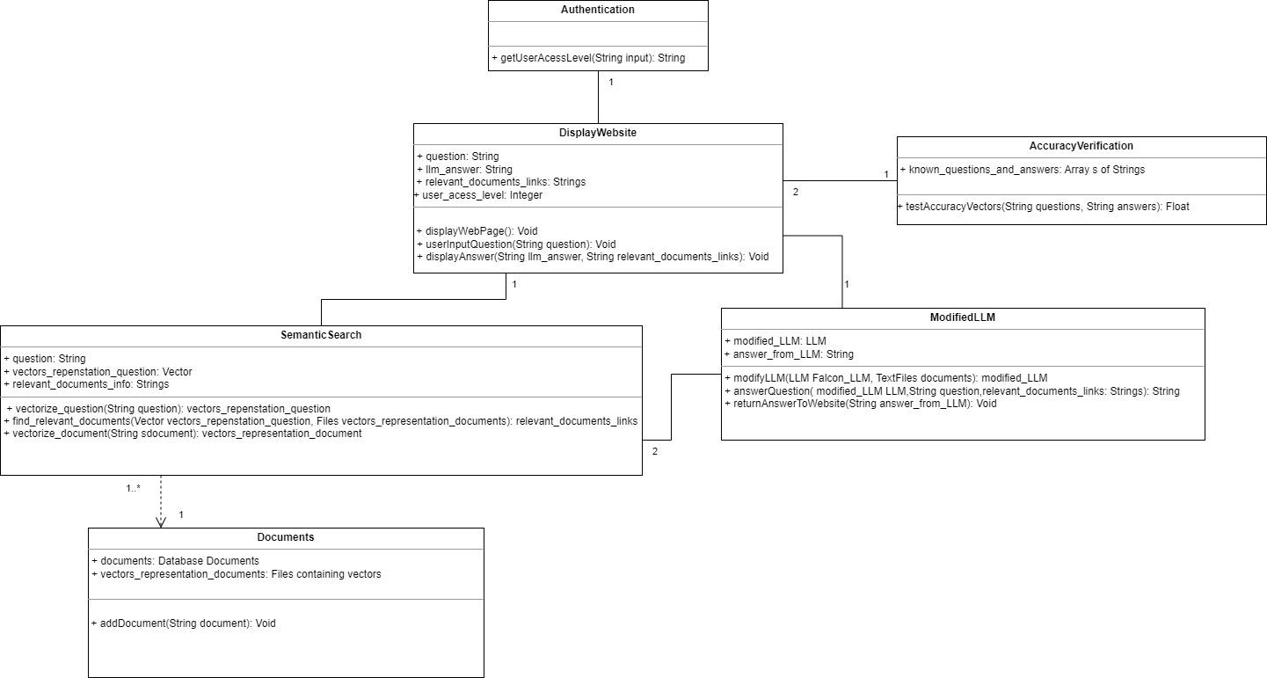
Class Diagram
Notes:
Falcon 7B and a tokenizer, from Hugging Face. Tokenizer prepares the inputs for the model, turns data into tokens.
We went with the Falcon 7B model as it performs well when compared to other open-source models like MPT-7B and StableLM. As it is made available with the Apache 2.0 license, it is usable without royalties or restrictions.
It requires 16 GB of memory, so it’s a good middle ground for performance and usability. The Falcon 7B Model is also meant to be fine tuned for most usecases, making it the perfect fit for our project.
Facebook AI Similarity Search, for the vector database, from META.
LangChain, to vectorize and index the database.
React, for frontend implementation.
GitHub and Google Colab, for code development.
TTU High Performance Computing Center (HPCC), to run and fine tune the falcon model.

Slide 9
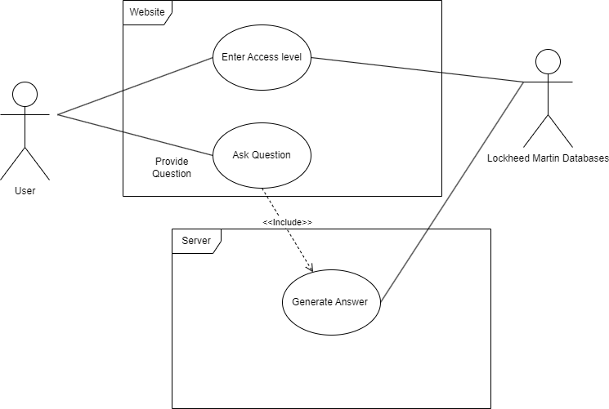
Use Case Diagram
Notes:
The AF-TOs contain a large amount of information, from technical definitions and explanations, to disclosures and other things pertaining to legality. One thing that was emphasized in our interviews was to prioritize returning correct definitions and explanations, rather than the disclosures and other related things.
We also discussed using Retrieval Augmented Generation, RAG, as the primary means of ordering our data. RAG will allow the LLM to search through a database for information related to the user’s question.
The last thing of importance in our interview was implementing a user guide on the webpage for the LLM. This would instruct the user on the proper syntax and guidelines for asking a question, one of these being to only ask one question at a time.
As a “stretch goal”, we discussed implementing an “Access Level” tool. This would allow the user to select some level of classification or access that they have, and would answer questions related to the documents they have access to. It was said to implement this as a proof of concept, having the user select which level of access they have rather than restricting it by an ID/Password system.

Slide 10
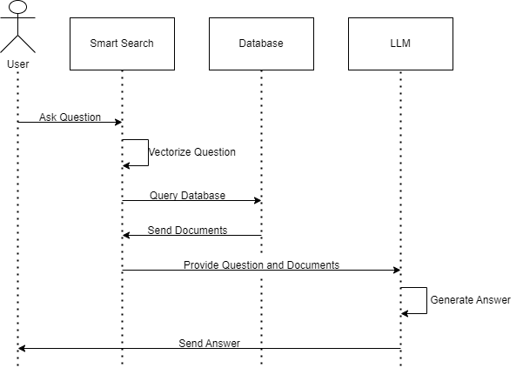
Sequence Diagram
Notes:
The AF-TOs contain a large amount of information, from technical definitions and explanations, to disclosures and other things pertaining to legality. One thing that was emphasized in our interviews was to prioritize returning correct definitions and explanations, rather than the disclosures and other related things.
We also discussed using Retrieval Augmented Generation, RAG, as the primary means of ordering our data. RAG will allow the LLM to search through a database for information related to the user’s question.
The last thing of importance in our interview was implementing a user guide on the webpage for the LLM. This would instruct the user on the proper syntax and guidelines for asking a question, one of these being to only ask one question at a time.
As a “stretch goal”, we discussed implementing an “Access Level” tool. This would allow the user to select some level of classification or access that they have, and would answer questions related to the documents they have access to. It was said to implement this as a proof of concept, having the user select which level of access they have rather than restricting it by an ID/Password system.

Slide 11
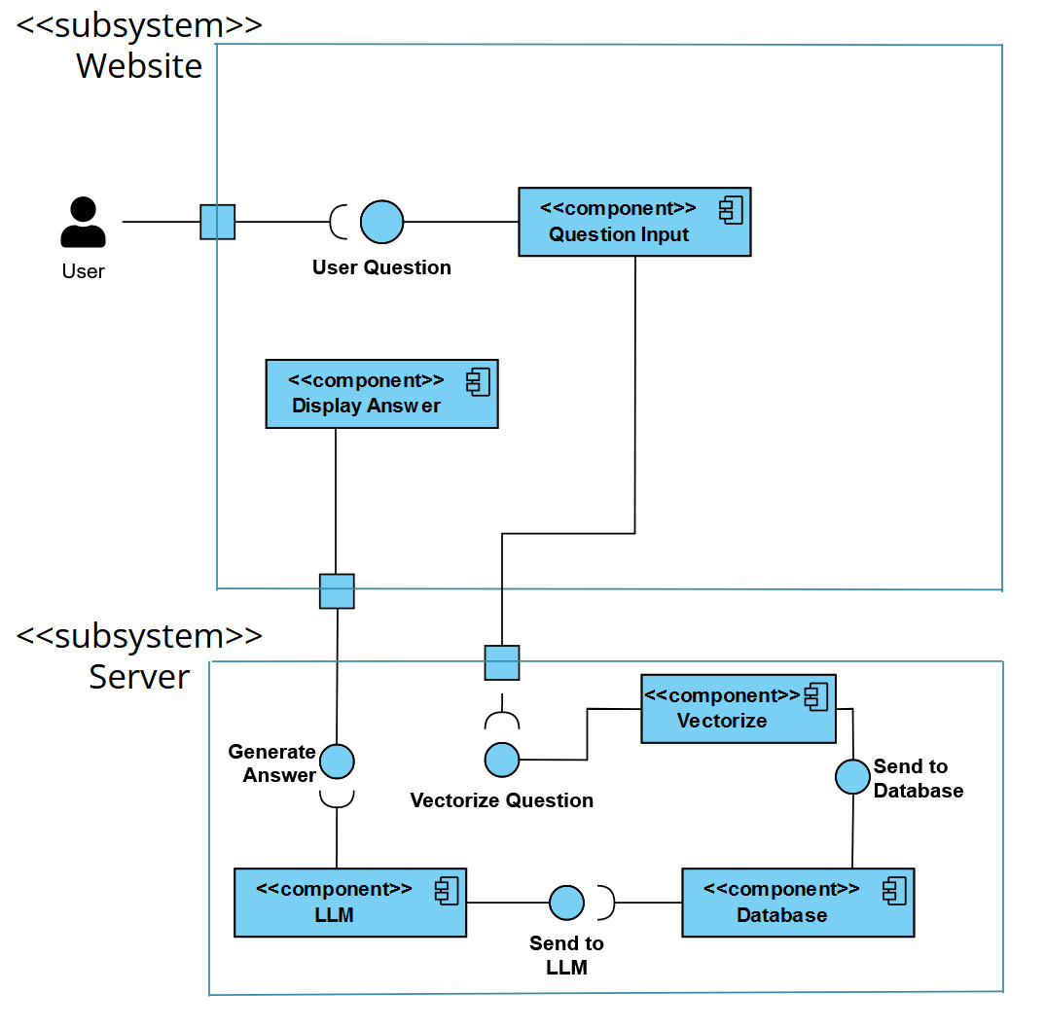
Component Diagram
Website
Takes user input
Displays generated answer and relevant document
Server
Vectorizes question
References Database
Sends info to LLM
LLM generates answer

Slide 12
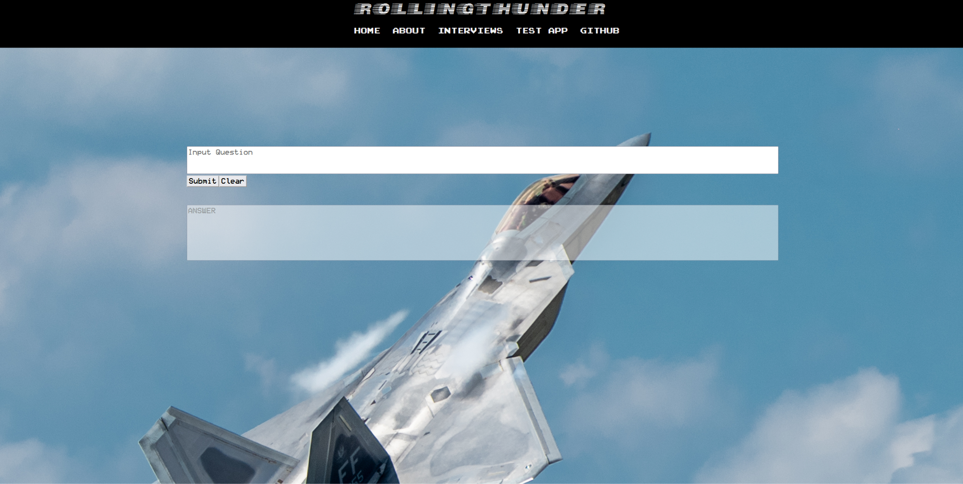
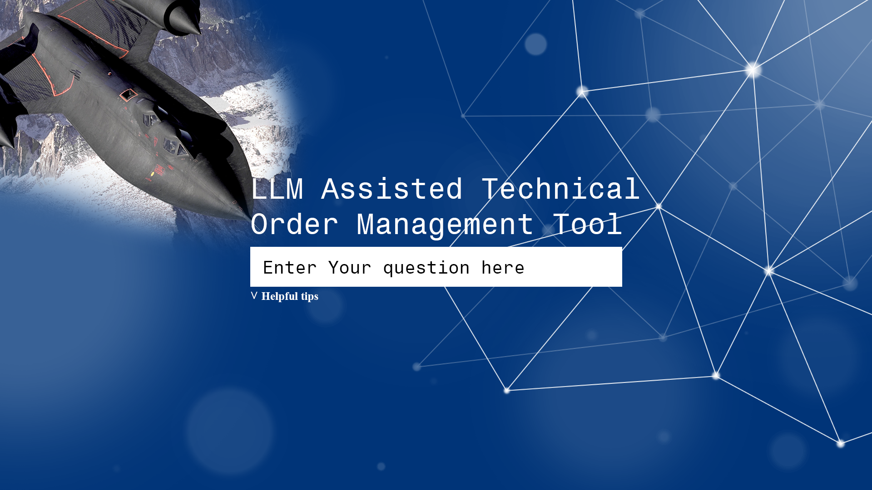
Prototype
Question Box
Prompt Engineering Tips Dropdown
Answer
Notes:
The AF-TOs contain a large amount of information, from technical definitions and explanations, to disclosures and other things pertaining to legality. One thing that was emphasized in our interviews was to prioritize returning correct definitions and explanations, rather than the disclosures and other related things.
We also discussed using Retrieval Augmented Generation, RAG, as the primary means of ordering our data. RAG will allow the LLM to search through a database for information related to the user’s question.
The last thing of importance in our interview was implementing a user guide on the webpage for the LLM. This would instruct the user on the proper syntax and guidelines for asking a question, one of these being to only ask one question at a time.
As a “stretch goal”, we discussed implementing an “Access Level” tool. This would allow the user to select some level of classification or access that they have, and would answer questions related to the documents they have access to. It was said to implement this as a proof of concept, having the user select which level of access they have rather than restricting it by an ID/Password system.

Slide 13
Working Model
Question Box
Answer

Slide 14
What’s Done (Implementation Plan)
First Stage
Base website capability -Karlton
Accept queries
Relay information
Display answers
Semantic search capability -David/Roman
Tokenization/Vectorization
Database searching
Relaying info to LLM
Base LLM capability -Team
Relatively reliable answers
Second Stage
Source Capability for LLM
Correctly sources info
Third Stage
Finishing touches -Team
Helpful tips on website
Make website professional
Add loading bar
Stretch Goals -Team
Access Control
Limit test with additional manuals

Slide 15
What’s Next / Future Plans
Implement Access Level control
Display and highlight PDFs in output
Implement all AF-TOs
Implement loading bar and tips on website
Resolve technical issues.
Google Colab has limited memory
Prevents 100% uptime and limits fine-tuning.

Slide 16
Demonstration & credits
https://karltonh.github.io/Rollingthunder_ttu/#/
“🤗 PEFT.” GitHub, 18 May 2023, github.com/huggingface/peft.
“balapv.“ Retrieval Augmented Generation Using Azure Machine Learning Prompt Flow (Preview) - Azure Machine Learning.” Learn.microsoft.com, 31 July 2023, learn.microsoft.com/en-us/azure/machine-learning/concept-retrieval-augmented-generation?view=azureml-api-2.

Slide 17
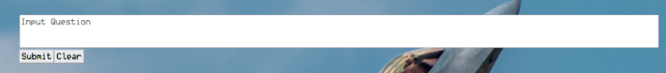
Semantic Search Steps - 1
User Inputs a question about a technical document (and inputs user access level)

Slide 18
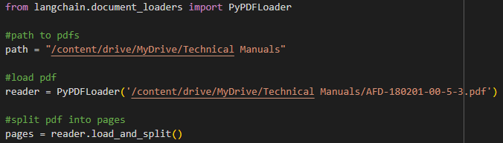
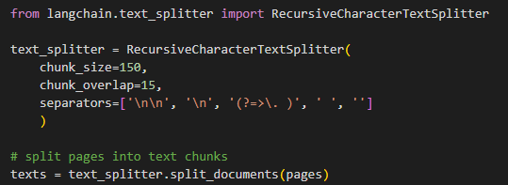
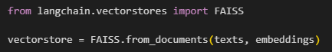
Semantic Search Steps - 2
All PDF’s within the access level are loaded and split into text chunks. Then stored within a vector store

Slide 19
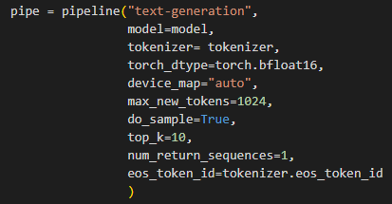
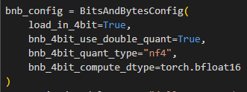
Semantic Search Steps - 3
LLM model is loaded using 4-bit quantization and with a sharded model to save on memory. Pipeline is set up

Slide 20
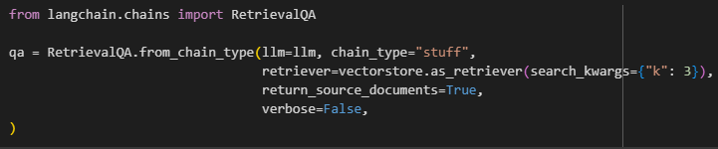
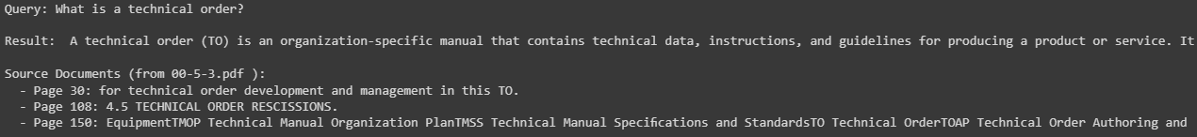
Semantic Search Steps - 4
Most relevant information is found and the LLM generates an answer using the question and relevant documents

Slide 21

Semantic Search Steps - 5
Answer is returned to the user through the website along with source information

Slide 22

Demonstration (video)

